Slide 1
DreamForge: Motion-Aware Autoregressive Video Generation for Multi-View Driving Scenes
Jianbiao Mei^{1,2}, Yukai Ma^{1,2}, Xuemeng Yang², Licheng Wen², Tiantian Wei^{2,3},
Min Dou², Botian Shi², and Yong Liu¹
¹Institute of Cyber-Systems and Control, Zhejiang University.
²Shanghai Artificial Intelligence Laboratory. ³Technical University of Munich.
Email: jianbiaomei@zju.edu.cn

Slide 2
Introduction
What is this paper about?
Diffusion-based autoregressive video generation model for long-term generation of 3D controllable and extensible video.
World dreamer for high-fidelity closed-loop simulation.
What dose this paper features?
Better controllability, supporting various control conditions and improve lane generation and foreground control through perspective guidance.
Better scalability, easily generating driving scenes for any city in the world by leveraging layouts from OpenStreetMap.
Better coherence, supporting flexible video lengths while maintaining coherence and consistency across multiple views and timeframes.

Slide 3
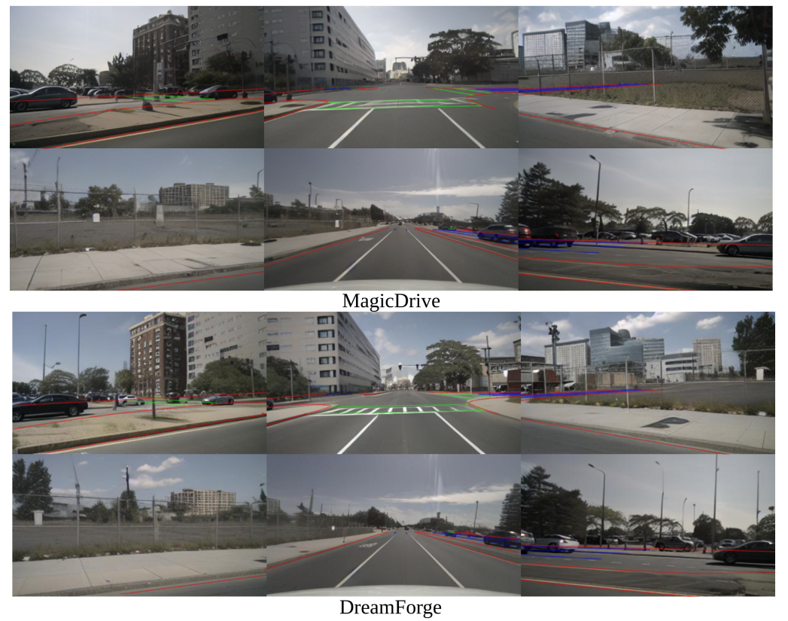
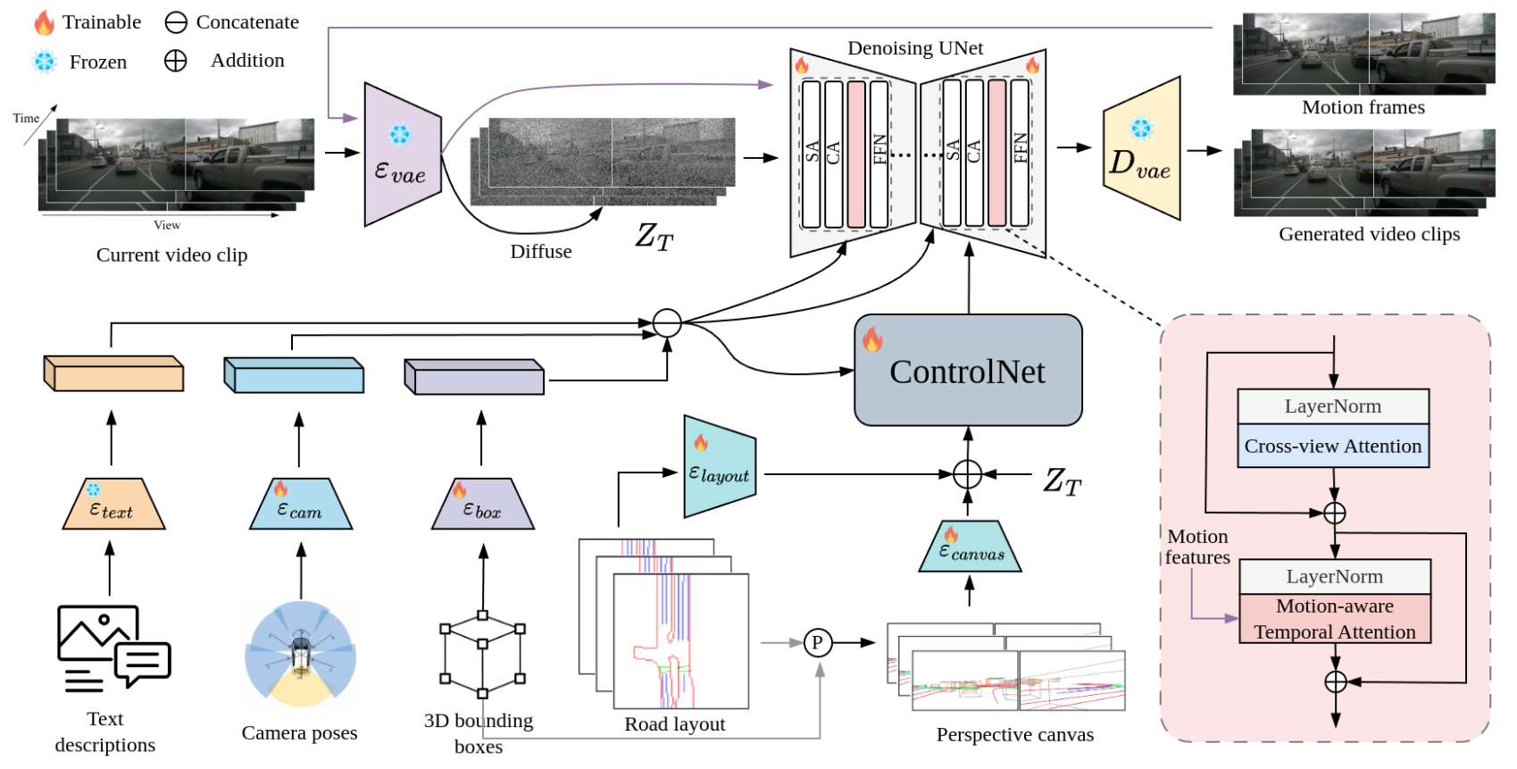
Method
Overall pipeline of the proposed DreamForge

Slide 4
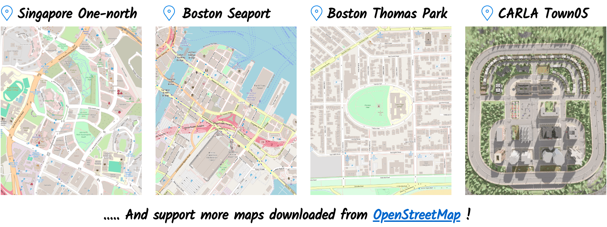
Generation results
Various layout
For more visualizations…
Long video generation (19s,12Hz) using 7-frame temporal model

Slide 5
Generation results
Various weather
A driving scene at sinaper-hollandvillage. Night, clear, suburban, streetlights.
A driving scene at boston-seaport. Rainy, cloudy, suburban, wet road.
A driving scene at boston-seaport. Daytime, sunny, suburban, straight road.

Slide 6
Generation results

Slide 7
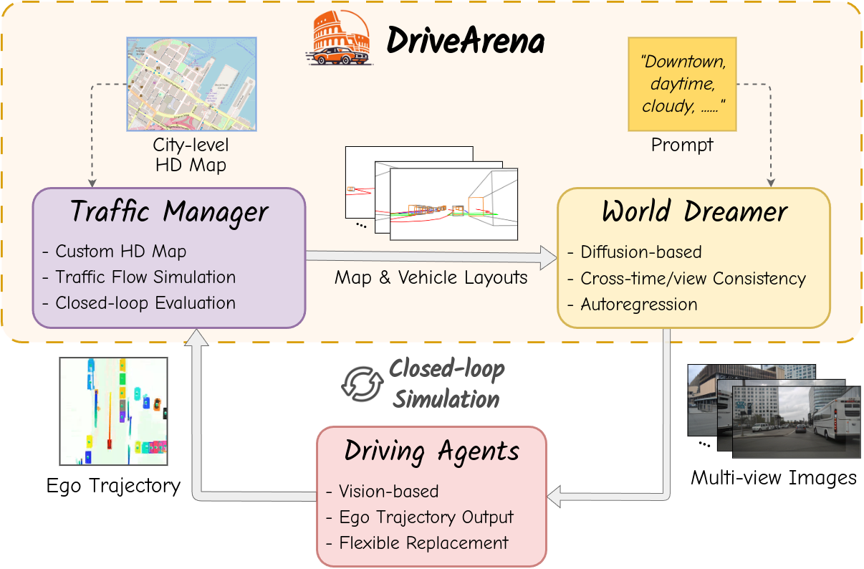
Diffusion-based Closed-loop Simulation
Reality: More realistic multi-view images and traffic flow.
Unlimited: Supports any road network downloaded from OpenStreetMap, allowing for diverse scene appearances.
Controllable: Limsim, as a simulation engine, can control any vehicles in the scene.
Stability: More stable than world models.
https://pjlab-adg.github.io/DriveArena.

Slide 8
Thank You for Your Attention
Jianbiao Mei^{1,2}, Yukai Ma^{1,2}, Xuemeng Yang², Licheng Wen², Tiantian Wei^{2,3},
Min Dou², Botian Shi², and Yong Liu¹
¹Institute of Cyber-Systems and Control, Zhejiang University.
²Shanghai Artificial Intelligence Laboratory. ³Technical University of Munich.
Email: jianbiaomei@zju.edu.cn

